Slide 1
Business Intelligence and Reporting
Parikshit Pandey
Yogen Sood

Slide 2
Index
Objective
Self Service Business Intelligence
Comparative study
Understanding the data
Exploring Sisense
Reporting in Google Data Studio
Self service tool using Python

Slide 3
Objective
Finding the best Self-service BI tool for data driven solution:
Research on the tools: Which is the best available tool for self-service BI.
Developing a self-service BI solution based on the sample data provided.

Slide 4
Self-Service Business Intelligence
Business Intelligence:
Business intelligence (BI) is a technology-driven process of transforming data into actionable insights, to help organizations to make more data-driven decisions.
It includes processes such as Data Mining, Visualization, Querying, Performance Metrics and Reporting.
Self Service BI:
Contrary to traditional BI, Self-service BI allows business users to create reports themselves, without needing assistance from the IT department.
It provides more flexibility, easier reporting and is time saving.

Slide 5
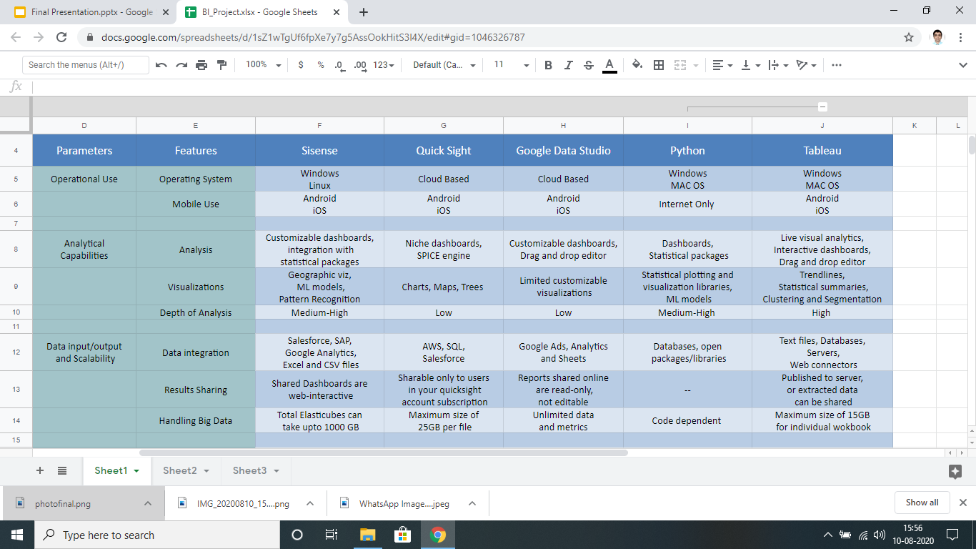
Comparative Study of BI Tools for SSC

Slide 6
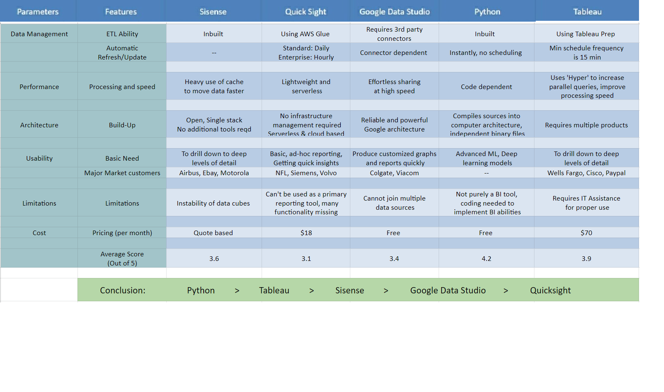

Slide 7
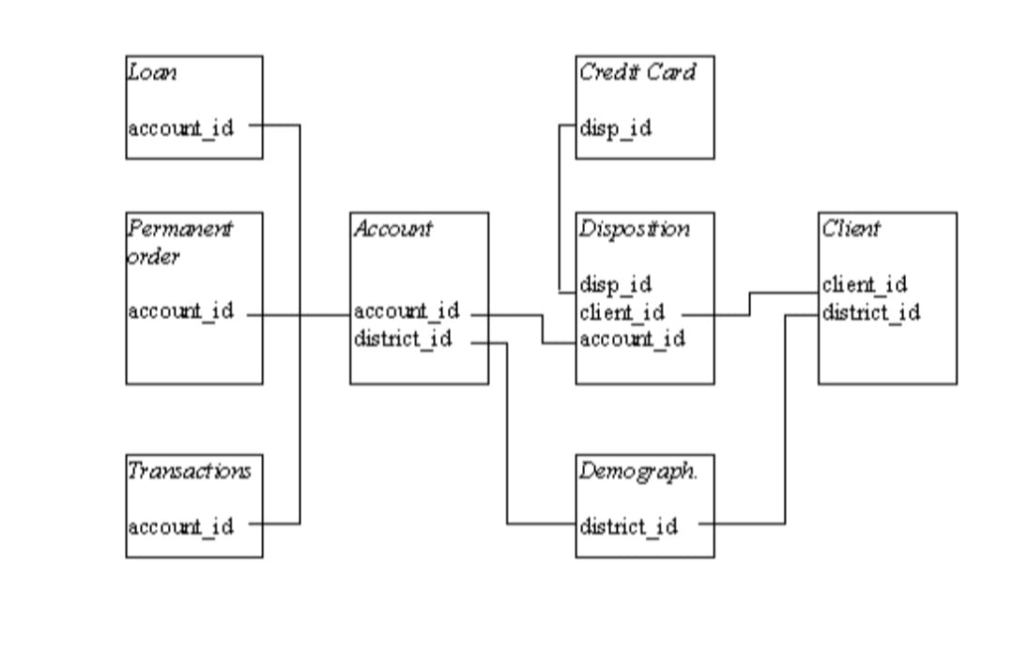
Understanding the Data
Clients
Accounts
Transactions
Orders
Districts
Loans
Cards
Dispositions

Slide 8
Sisense

Slide 9
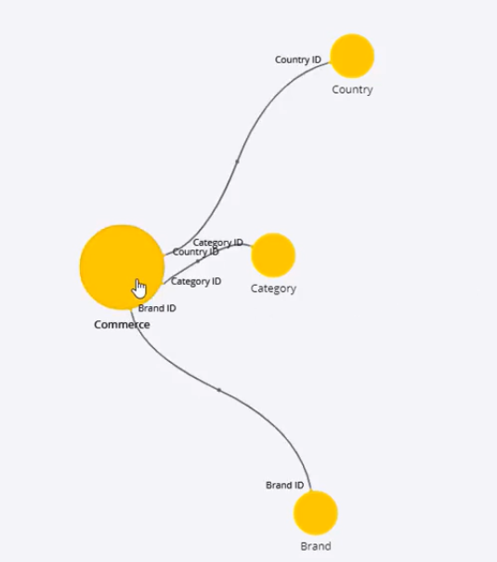
Data Storage
Elasticubes:
The ElastiCube is Sisense’s high-performance analytics database designed to withstand extensive querying.
Serves the purpose of dedicated OLAP cubes or optimized data marts, which would otherwise have to be created separately.

Slide 10
Inbuilt ETL Capability
Drawbacks:
Very RAM-Intensive software, high system requirements to run.
Limited memory available for use in free trial version.
Technologies:
Columnar Database
In-Chip Technology
Scheduling Builds:
Replace All
By Table
Changes only
Transform Operations:
Adding custom tables, SQL statements.
Previewing table result.
Custom columns and field formulas.

Slide 11
Google Data Studio

Slide 12
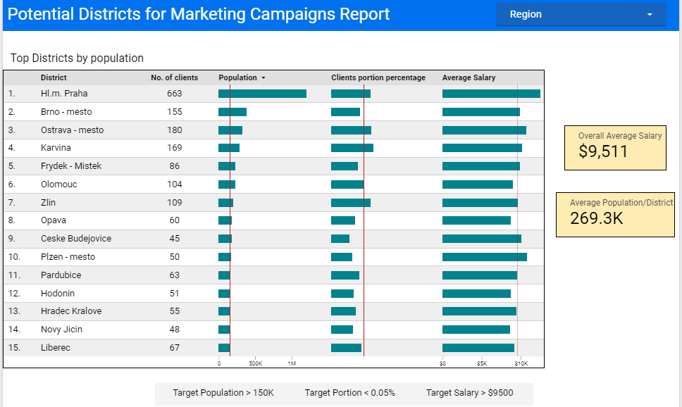
Reporting

Slide 13
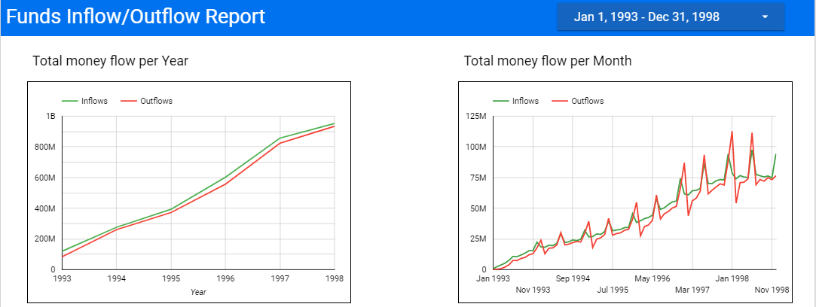
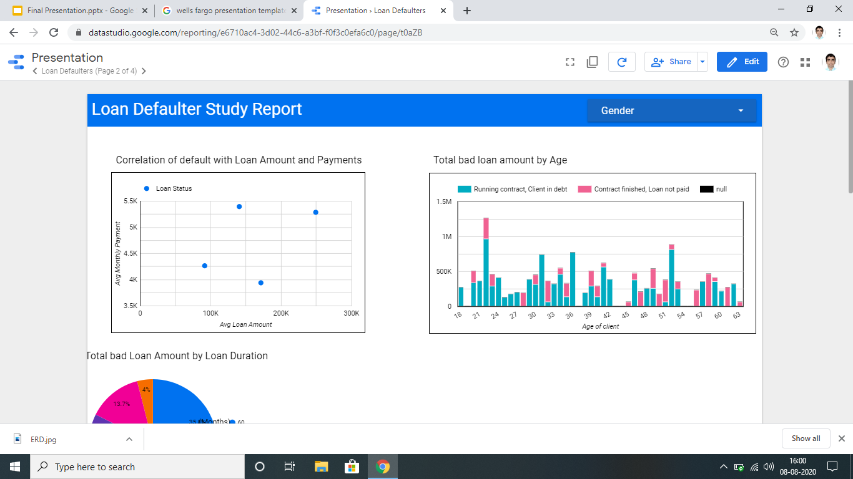

Slide 14
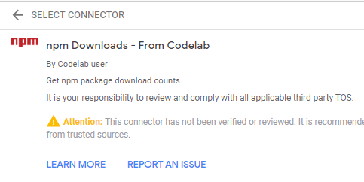
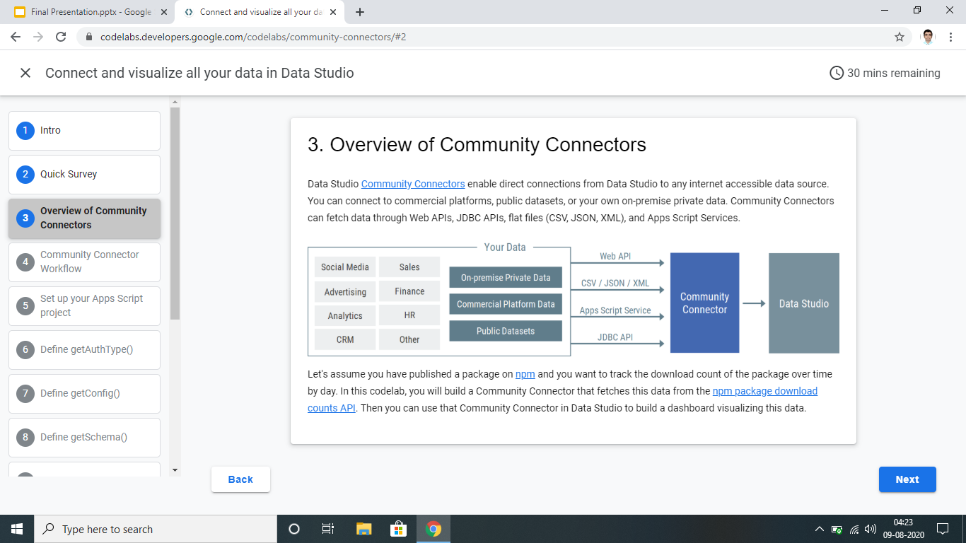
Community Connectors
Community Connectors is a feature for Data Studio that lets you use Apps Script to build connections to any internet accessible data source.
getAuthType()
getConfig()
getSchema()
getData()

Slide 15
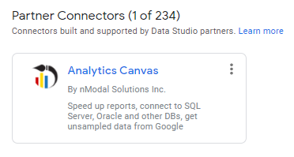
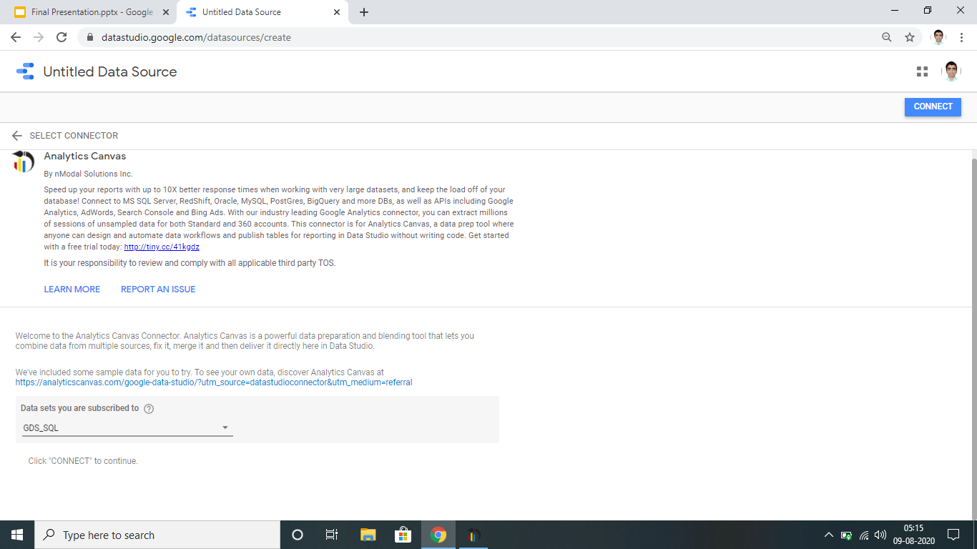
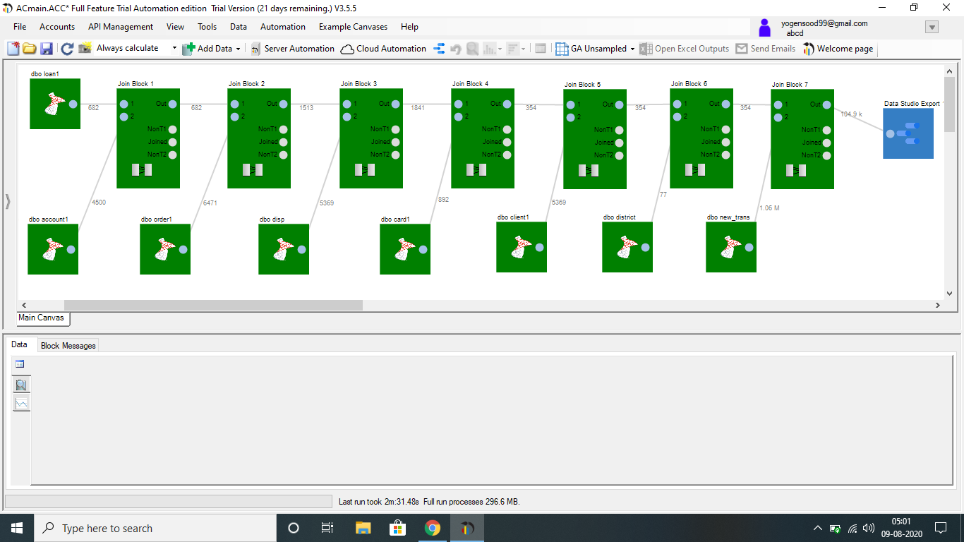
Connecting to SQL server

Slide 16
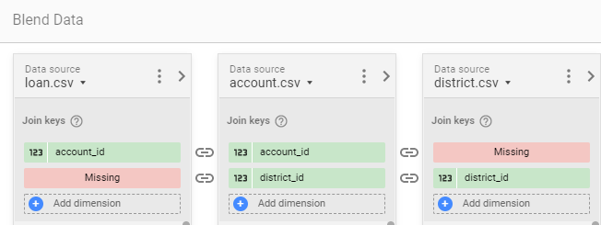
Drawbacks
Inability to join 3 or more tables on different keys.
Cannot preview data while performing visualizations.
Free to use but some functions require Cloud subscription.

Slide 17
Python

Slide 18
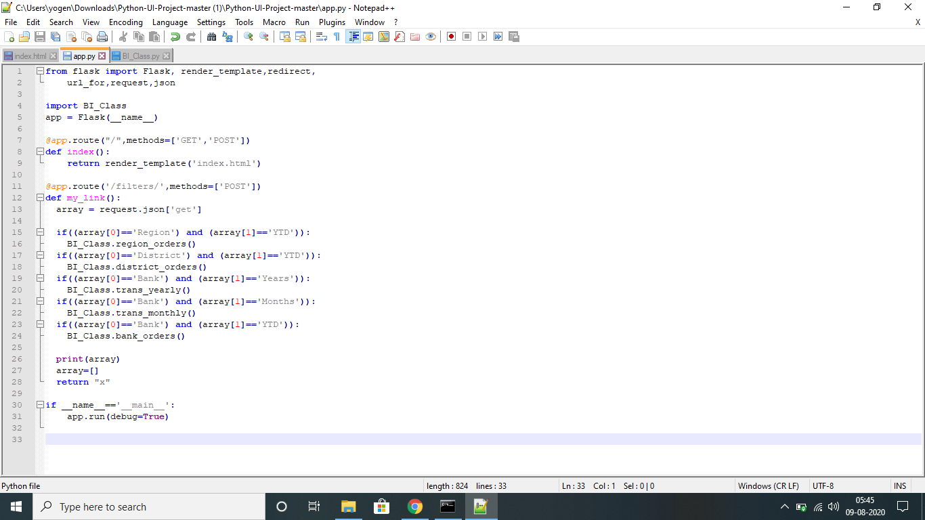
Self-Service solution using Python
Tools Used:
Python (flask, pptx)
HTML
AJAX Method
Product:
A web-based UI where users choose their dimensions and metrics and get to download a PPT having charts and tables corresponding to the selections made.

Slide 19
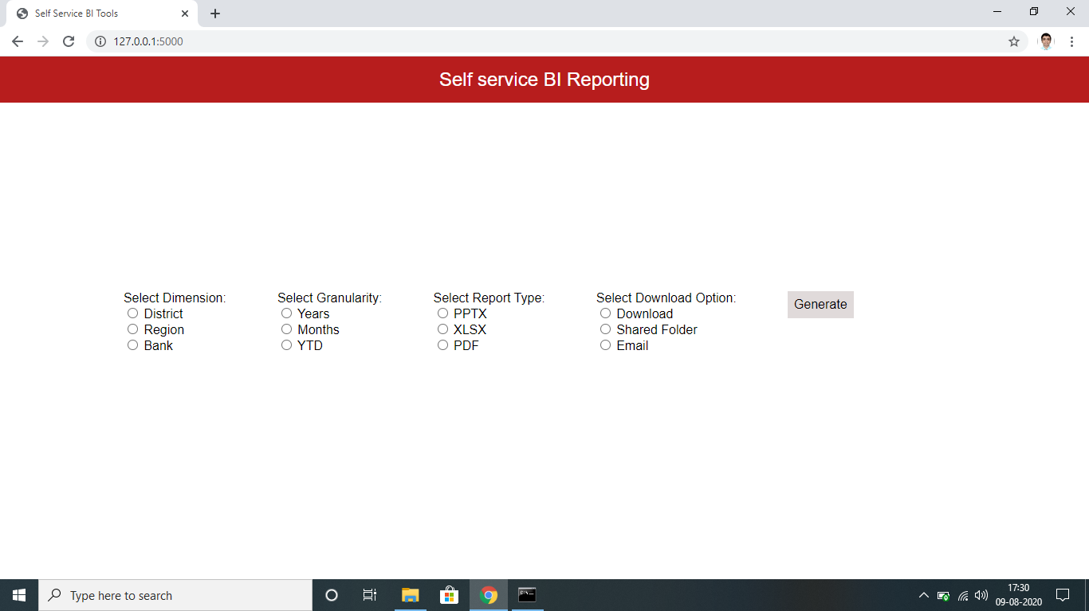
User Interface

Slide 20
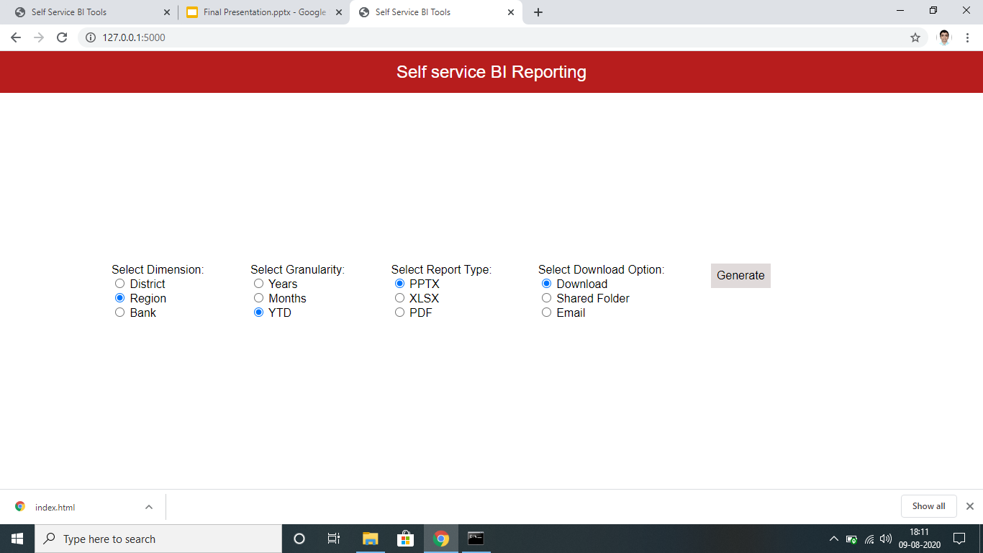

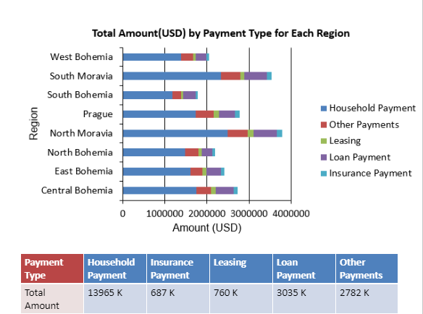
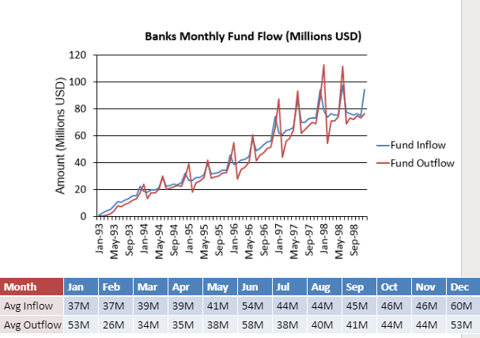
Results

Slide 21
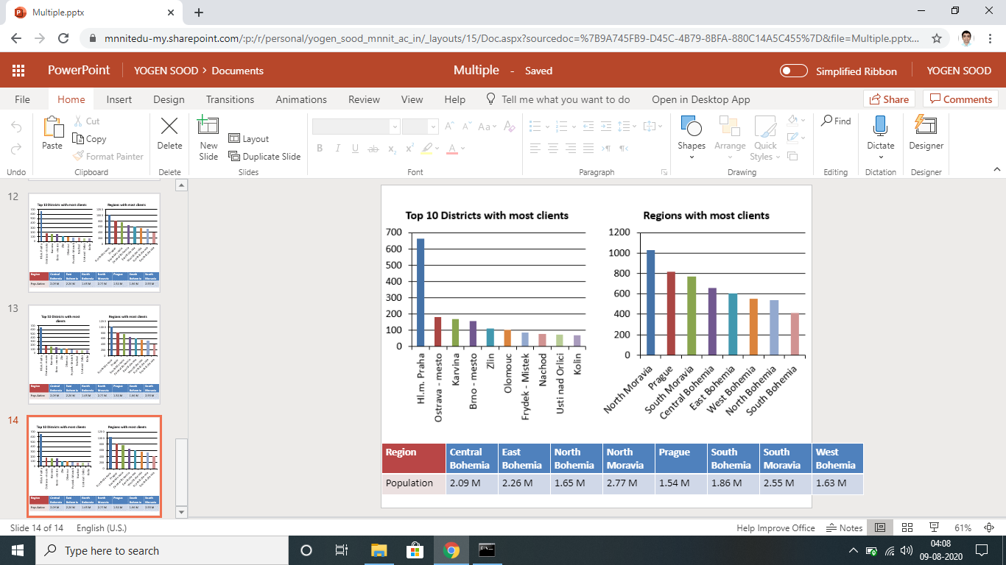
Customization and Flexibility
More options:
Adding text and pictures/ logos.
Adding autoshapes.
Adding multiple slides in the same PPT file for multiple user selections.
Multiple charts in the same slide:

Slide 22
Key Takeaways
Thorough research comparing various popular BI tools in the market.
Brief study on Sisense’s extra edge in data warehousing and ETL Ability.
Extensive work on Google Data Studio understanding its analytical, reporting and self-serve capabilities.
Exploring other functionalities that are possible beyond these tools by building a small-scale self-serve solution in Python.

Slide 23
Thank You

